Slide 1


Slide 2
Definition of E- Commerce
E-Commerce or Electronic Commerce means buying and selling of goods, products, or services
over the internet.
E-commerce is also known as electronic commerce or internet commerce.
Transaction of money, funds, and data are also considered as E-commerce.
These business transactions can be done in four ways: Business to Business (B2B), Business to
Customer (B2C), Customer to Customer (C2C), Customer to Business (C2B).

Slide 3
Main components of E-Commerce
The components of E-Commerce are as follows:
1. User: This may be individual / organization or anybody using the e-commerce platforms.
2. E-commerce vendors: This is the organization/ entity providing the user, goods/ services. E.g.: www.flipkart.com. E-commerce Vendors further needs to ensure following for better, effective and efficient transaction.
− Suppliers and Supply Chain Management
− Warehouse operations
− Shipping and returns
− E-Commerce catalogue and product display
− Marketing and loyalty programs
3. Technology Infrastructure: This includes Server computers, apps etc. These are the backbone for the success of the venture. They store the data/program used to run the whole operation of the organization.
4. Internet/ Network: This is the key to success of e-commerce transactions. Internet connectivity is important for any e-commerce transaction to go through. The faster net connectivity leads to better e-commerce.
5. Web Portal: This shall provide the interface through which an individual/organization shall perform e-commerce transactions. These web portals can be accessed through desktops/laptops/PDA/hand- held computing devices/ mobiles and now through smart TVs.
6. Payment Gateway: The payment mode through which customers shall make payments. Payment gateway represents the way e-commerce vendors collect their payments. Examples are Credit / Debit Card Payments, Online bank payments, Vendors own payment wallet, Third Party Payment wallets, like PAYTM and Unified Payments Interface (UPI).

Slide 4
Elements of E-Commerce security
E-commerce security involves safeguarding online transactions and protecting sensitive information during online purchases. Here are some key elements:
Encryption: Encrypting data ensures that sensitive information like credit card details, personal information, and transaction data is encoded during transmission
Secure Payment Gateways: Using trusted and secure payment gateways ensures that financial information is transmitted securely between the customer, merchant, and financial institutions.
3. Firewalls and Security Software: Implementing firewalls and up-to-date security software
helps prevent unauthorized access to the e-commerce website's network.
4. Authentication and Authorization: Employing strong user authentication methods, such
as two-factor authentication (2FA), helps verify the identity of users, reducing the risk of
unauthorized access.
Notes:
. Secure Sockets Layer (SSL) or Transport Layer Security (TLS) protocols are commonly used to encrypt data.
This includes protection against malware, viruses, and other cyber threats.

Slide 5
6. Regular Updates and Patch Management: Ensuring that the e-commerce platform and all
associated software are regularly updated with the latest security patches helps mitigate
vulnerabilities that could be exploited by attackers.
7. Data Privacy and Compliance: Adhering to data privacy regulations (such as GDPR, CCPA)
and implementing privacy policies that protect customer data is crucial. This includes proper
handling and storage of personal information.
8. Risk Assessment and Monitoring: Conducting regular security audits and risk assessments
helps identify potential vulnerabilities and threats. Continuous monitoring of systems for
suspicious activities is vital to detect and respond to any security breaches promptly.

Slide 6
9. Customer Education: Educating customers about safe online practices, such as creating strong passwords, avoiding public Wi-Fi for sensitive transactions, and being cautious of phishing attempts, can significantly enhance overall e-commerce security.
10. Physical Security Measures: Ensuring physical security of servers and data centers where customer information is stored is essential to prevent unauthorized access to hardware and infrastructure.
11. Backup and Disaster Recovery: Implementing robust backup and disaster recovery plans ensures that in case of a security breach or system failure, data can be recovered without significant loss.

Slide 7

Top 8 E-Commerce Security Threats and Issues You Must Know
1. Financial Fraud
Cybercriminals often target payment transactions, attempting to siphon funds from unsuspecting users. These threats range from credit card fraud to identity theft.
2. Credit Card Fraud
This fraud is carried out through a stolen credit card or through identity theft which enables the fraudster to create a credit card with that identity. Carding, a practice where small transactions are made to test the validity of stolen credit card details, is another common threat. Transactions with stolen credit cards can be limited by installing address verification systems. These systems check and verify between the billing addresses provided by the customer to you and the bank.
3. Refund Fraud
Another trick up a fraudster’s sleeve is to file requests for refunds or returns for non-existent orders or after using the products. They can also perform unauthorized transactions and clear the trail, causing a loss of revenue for your e-commerce business.
4. Phishing
Phishing attacks involve deceptive emails or websites that appear legitimate but are designed to trick users into revealing their personal and financial information. Customers can receive messages or emails from hackers pretending to be your e-commerce business. They present fake copies of your website pages or another reputable website to trick the users into believing them, and phishing simulation tools can replicate these tactics to educate your staff and test their vigilance. This can pose a grave problem in the trust customers have with your business.
5. DDoS Attacks
Distributed Denial of Service (DDoS) attacks flood a website with overwhelming traffic rendering it inaccessible to legitimate users. E-commerce businesses are attractive targets. Such a threat can cause your e-commerce platforms to crash resulting in hefty sales and revenue loss. Such attacks are one of the most critical security issues in e-commerce that can severely disrupt operations.

Slide 8
6. Spamming
Spam emails, comments, and messages can clutter & disrupt the experience of your e-commerce platform. They can also have malware or phishing links. They can also leave these links in their comments on blog posts and contact forms. Clicking such a link directs your customers to malicious sites. Spamming not only affects your website’s security but also reduces its speed and performance drastically.
7. Bots
Bots can be programmed to perform tasks like scraping data (e.g., to collect Amazon product details), automating purchases, or launching attacks. Malicious bots can wreak havoc on e-commerce sites by scraping them for inventory and price information. Hackers can then use the data to lower or modify the prices on their websites in an attempt to lower your sales and revenue.
8. Brute Force Attacks
Brute force attacks involve repeated, automated login attempts to gain unauthorized access to user accounts. Attackers can use brute force to attack your administrator panel, crack your password, and compromise your account to steal information. Automated tools help in trying out thousands of combinations in an attempt to obtain your site’s passwords. It’s wise to use strong, complex passwords and change them every few months.
9. Vulnerability Exploitation
Vulnerabilities that exist in your e-commerce website can be exploited by hackers using SQL injections or cross-site scripting (XSS). SQL injections affect your database by corrupting it using codes that are put into query boxes on your site. XSS targets the users with the aid of malicious code snippets that are planted in your site allowing hackers to access customers’ cookies.
10. Malware
Malicious software like spyware, viruses, trojans, and ransomware is installed on your IT and computer systems without your knowledge. Customers, admin, and other user devices may have trojan horses that can easily swipe away any sensitive information from it and in the process affect your e-commerce site as well.

Slide 9
Top Solutions For E-Commerce Security Threats
Solution 1: Implement A Secure Firewall
Solution 2: Secure Payment Gateways
Solution 3: Switch to HTTPS Protocol
Solution 4: Carry out Vulnerability Scan
Solution 5: Use Anti-malware and Anti-Virus Software
Solution 6: Have a Multi-layered Security
Solution 7: Have Backups for Data
Solution 8: Stay Current on E-commerce Threats
Solution 9 Use Secure Sockets Layer (SSL) Encryption
Notes:
To combat these risks, eCommerce security solutions have become essential for protecting both business operations and customer data. Top e-commerce threats necessitate the implementation of the top e-commerce security solutions. Here is a noteworthy list of e-commerce security solutions.
Solution 1: Implement A Secure Firewall
A robust firewall system like Astra Firewall can detect and mitigate DDoS attacks on websites. It acts as a barrier against malicious traffic and ensures that your e-commerce site remains accessible and keeps away fishy networks, XSS, SQL injection, and DDoS attacks. They also help regulate network traffic to and from your online store.
Solution 2: Secure Payment Gateways
Do not store client credit card information on your database. Rather, use trusted third-party services like PayPal and Stripe to handle payment transactions away from your website. This ensures better safety for your customers’ personal and financial data. If your business does store financial information, compliance with PCI-DSS is mandatory.
Solution 3: Switch to HTTPS Protocol
Using outdated HTTP protocols can put your e-commerce website and your customers at risk. Proper encryption software will use HTTPS to encrypt data transmitted between the user’s browser and the website. It displays a trustworthy green lock symbol on the URL bar. This ensures that sensitive information submitted by customers and their user data remains confidential, enhancing overall eCommerce security.
HTTP protocols are defunct and most browsers either display users with a warning message or outright block access to such sites. Switch to HTTPS as it also will help your e-commerce business rank better on Google (you can track website rankings with Backlinko’s free tool) since HTTPS is a ranking factor for it.
Solution 4: Carry out Vulnerability Scans
Use automated vulnerability scanning tools like Astra Vulnerability Scanner or OWASP ZAP to carry out quick website vulnerability scans. Ensure that the tools also provide vulnerability scan reports with severity scores and remediation steps so that mitigation of the vulnerabilities is easier for you. The tool should also have a wide, constantly evolving vulnerability database for the detection of the latest vulnerabilities.
Solution 5: Use Anti-malware and Anti-Virus Software
Regularly scan your website for malware using anti-malware and antivirus software. This helps identify and eliminate malicious code, reducing the risk of spamming and malware infections. AI content generators can also assist in creating unique and engaging content that enhances your website’s value to customers.
Anti-malware software helps detect, remove, and prevent infectious software from infecting your devices and systems. On the other hand, antivirus software keeps viruses at bay.
Solution 6: Have a Multi-layered Security
Utilize a multi-layer security approach that includes CAPTCHA tests, and bot detection tools to differentiate between genuine users and malicious bots. Multifactor authentication can be enabled too so that genuine customers have the additional security and it protects your site from any unauthorized requests. 2FA which uses OTP (one-time password) with personal identification is a popular method of authentication.
Solution 7: Have Backups for Data
Regularly back up your website data and configurations. This helps you quickly restore your e-commerce platform to a clean state in case of a breach or attack. Having backups minimizes the downtime, data loss, and revenue loss experienced by your business.
Solution 8: Stay Current on E-commerce Threats
Continuously monitor your website’s software using Pagerduty alternatives to detect and mitigate vulnerabilities. It is vital that as an e-commerce business owner, you stay informed about evolving threats that can affect your business. Your employees and customers should also have awareness of the latest knowledge concerning handling user data and safe website engagement. It is also important to revoke access for former employees from your systems.
Conclusion

Slide 10
Introduction to Digital Payments
Digital payments are payments done through digital or online modes, with no exchange of hard
cash being involved. Such a payment, sometimes also called an electronic payment (e-payment),
is the transfer of value from one payment account to another where both the payer and the
payee use a digital device such as a mobile phone, computer, or a credit, debit, or prepaid card.
▪ The payer and payee could be either a business or an individual. This means that for digital
payments to take place, the payer and payee both must have a bank account, an online banking
method, a device from which they can make the payment, and a medium of transmission,
meaning that either they should have signed up to a payment provider or an intermediary such
as a bank or a service provider.

Slide 11
Components of Digital Payment and Stake holders
Digital payments involve several components and stakeholders that collectively facilitate the transfer of money or transactions through electronic means.
▪ Here are the key components and stakeholders:
1. Payment Gateway: It's the technology that authorizes and facilitates transactions by connecting merchants, banks, and customers. It encrypts sensitive information and ensures secure transfer.
2. Payment Processor: Responsible for managing the transaction process by transmitting data between the merchant's bank and the customer's bank. It verifies transaction details and ensures funds are transferred.
3. Mobile Wallets: Apps or platforms that store payment information, allowing users to make transactions through their smartphones. Examples include Apple Pay, Google Pay, and PayPal.
4. Digital Currencies/Cryptocurrencies: These decentralized forms of currency (like Bitcoin or Ethereum) facilitate peer-to-peer transactions through blockchain technology.
5. Near Field Communication (NFC): Technology that enables contactless payments by allowing devices to communicate when in close proximity.
6. QR Codes: Scannable codes that store payment information, enabling easy transactions by
simply scanning the code.

Slide 12
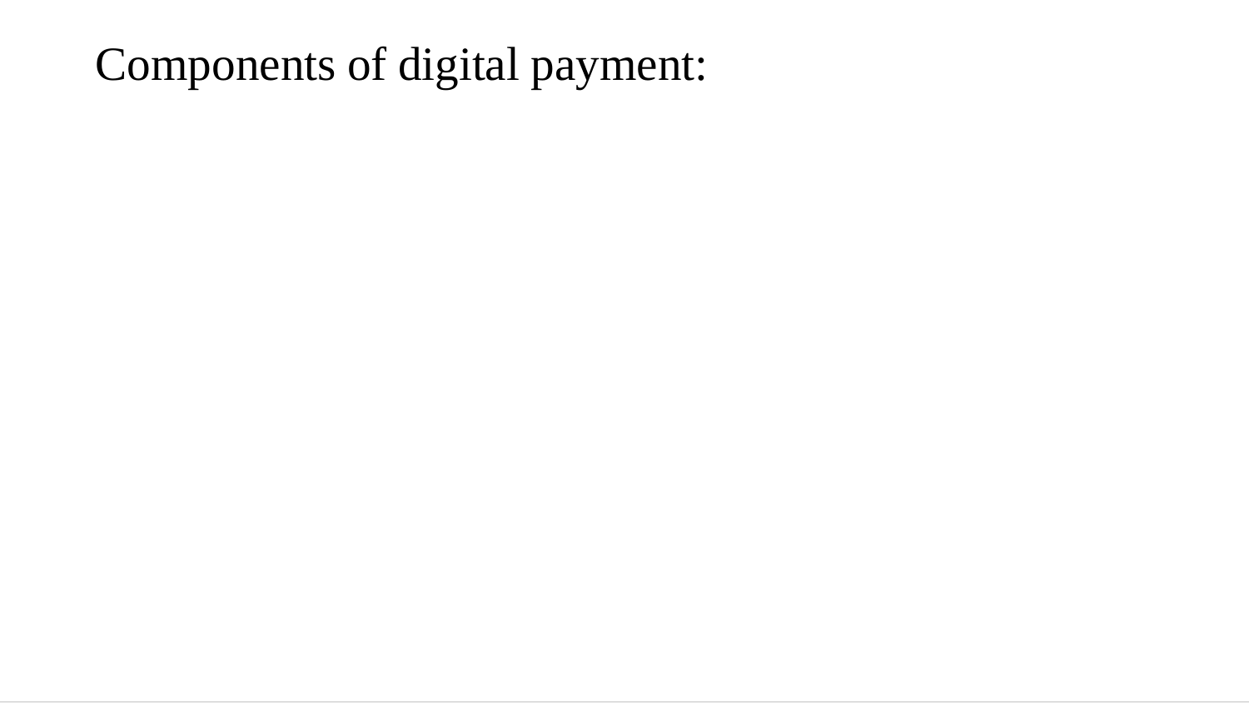
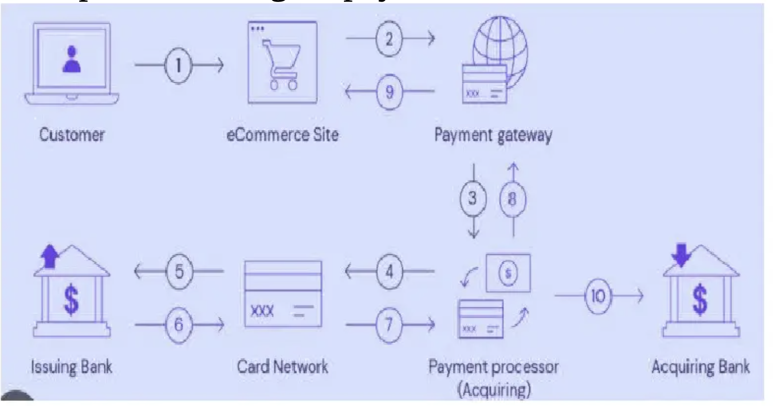

Slide 13
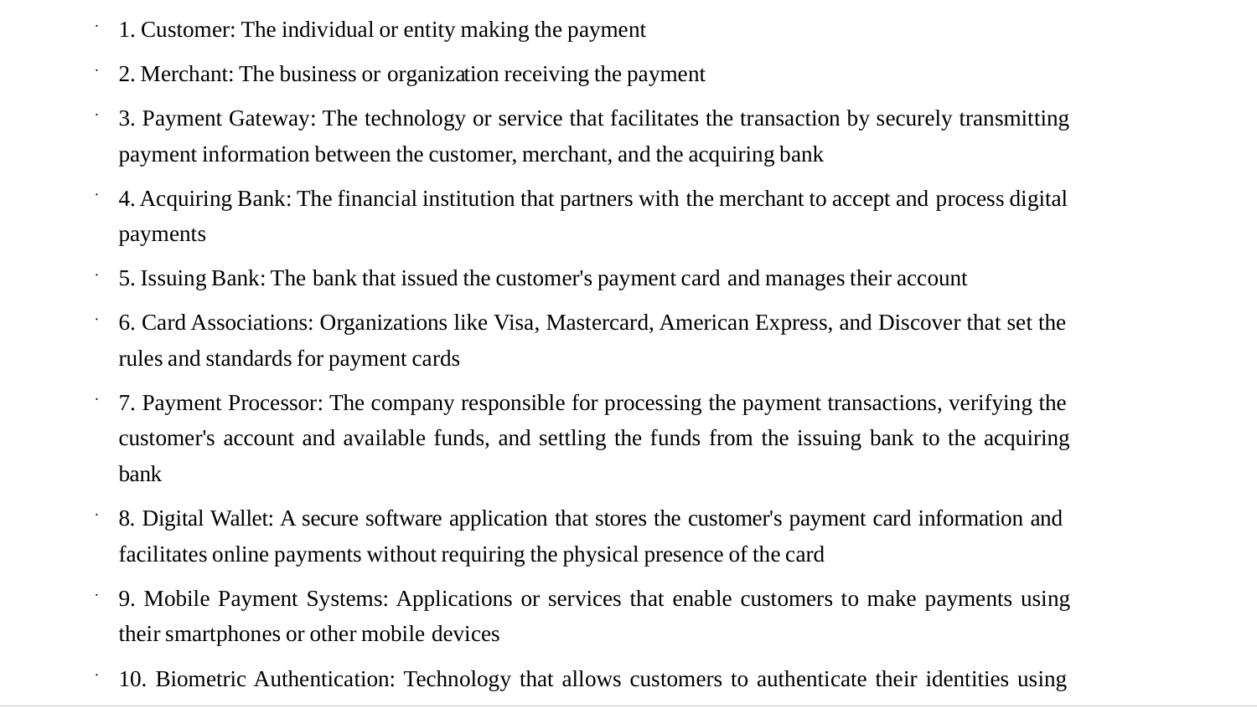

Slide 14
Stakeholders
1. Customers/Users: Individuals or entities making payments or transactions using digital payment methods.
2. Merchants/Retailers: Businesses or individuals selling goods or services and accepting digital payments from customers.
3. Financial Institutions: Banks, credit unions, and other financial entities that provide the infrastructure and accounts necessary for digital transactions.
4. Payment Service Providers (PSPs): Companies that offer services facilitating digital payments for merchants, such as amazon Blinkit.
5. Regulatory Bodies/Government Agencies: Entities responsible for creating and enforcing rules, regulations, and standards for digital payments to ensure security and fairness.
6. Technology Providers: Companies developing and maintaining the technology and software necessary for secure digital payment systems, including hardware manufacturers and software developers.
7. Security Firms: Organizations specializing in ensuring the security of digital payment
systems by providing encryption, fraud detection, and cybersecurity services.
These components and stakeholders collectively form the ecosystem that enables the seamless
execution of digital payments across various platforms and devices.

Slide 15
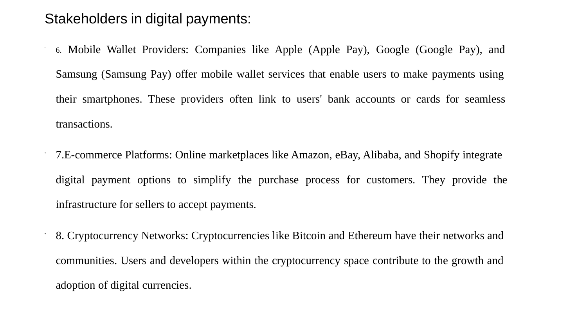

Slide 16
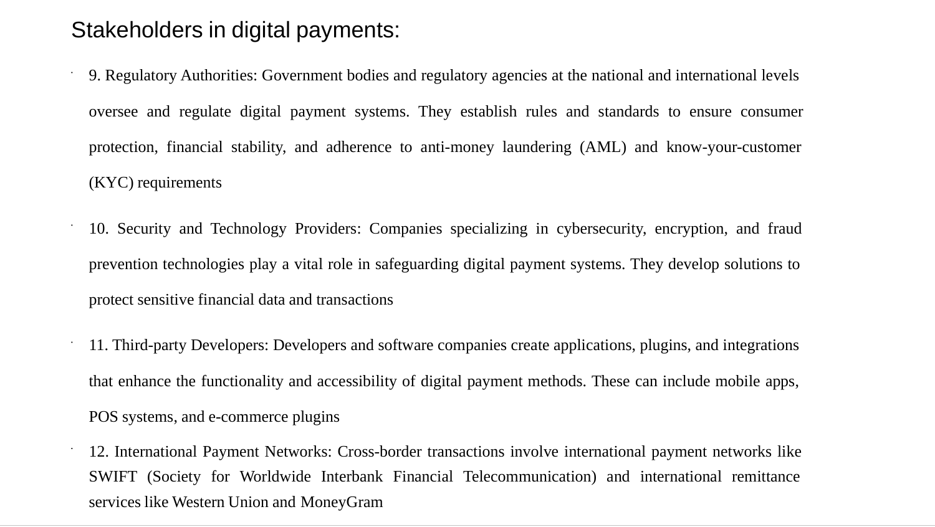

Slide 17
Modes of digital payments
There are various modes of digital payments that have become increasingly popular due to their
convenience and accessibility.
▪ Here's a brief overview of each:
1. Banking cards:
Cards are among the most widely used payment methods and come with various features and benefits such as security of payments, convenience, etc. The main advantage of debit/credit or prepaid banking cards is that they can be used to make other types of digital payments.
For example, customers can store card information in digital payment apps or mobile wallets to make a cashless payment. Some of the most reputed and well-known card payment systems are Visa, Rupay and MasterCard, among others. Banking cards can be used for online purchases, in digital payment apps, PoS machines, online transactions, etc.
2. Unified Payment Interface (UPI)
UPI is a payment system that culminates numerous bank accounts into a single application, allowing the transfer of money easily between any two parties. As compared to NEFT, RTGS, and IMPS, UPI is far more well-defined and standardized across banks. You can use UPI to initiate a bank transfer from anywhere in just a few clicks.
The benefit of using UPI is that it allows you to pay directly from your bank account, without the need to type in the card or bank details. This method has become one of the most popular digital payment modes in 2020, with October witnessing over 2 billion transactions.
Notes:
NEFT – National Electronic Funds Transfer RTGS – Real Time Gross Settlement IMPS – Immediate Payment Service
NEFT: Batch-based fund transfer (processed in intervals) RTGS: Real-time transfer for large amounts IMPS: Instant transfer available 24×7, even for small amounts

Slide 18
Electronic wallets or e-wallets store financial information and allow users to make online transactions quickly. E-wallet is a type of pre-paid account in which a user can store his/her money for any future online transaction.
4. Unstructured Supplementary Service Data (USSD)
USSD technology enables mobile banking services through basic phones, allowing users to access banking services by dialing a shortcode.
This method doesn't require internet connectivity and is particularly beneficial in regions with limited internet access. USSD was launched for those sections of India’s population which don’t have access to proper banking and internet facilities.
Under USSD, mobile banking transactions are possible without an internet connection by simply dialing *99# on any essential feature phone.
Notes:
An E-wallet is protected with a password. With the help of an E-wallet, one can make payments for groceries, online purchases, and flight tickets,
among others.
E-wallet has mainly two components, software and information. The software component stores personal information and provides security and encryption of the data. The information component is a database of details provided by the user which includes their name, shipping address, payment method, amount to be paid, credit or debit card details, etc. Services like PayPal, Google Pay, Apple Pay, and Paytm fall under this category.
This number is operational across all Telecom Service Providers (TSPs) and allows customers to avail of services including interbank account to account fund transfer, balance inquiry, and availing mini statements. Around 51 leading banks offer USSD service in 12 different languages, including Hindi & English.

Slide 19
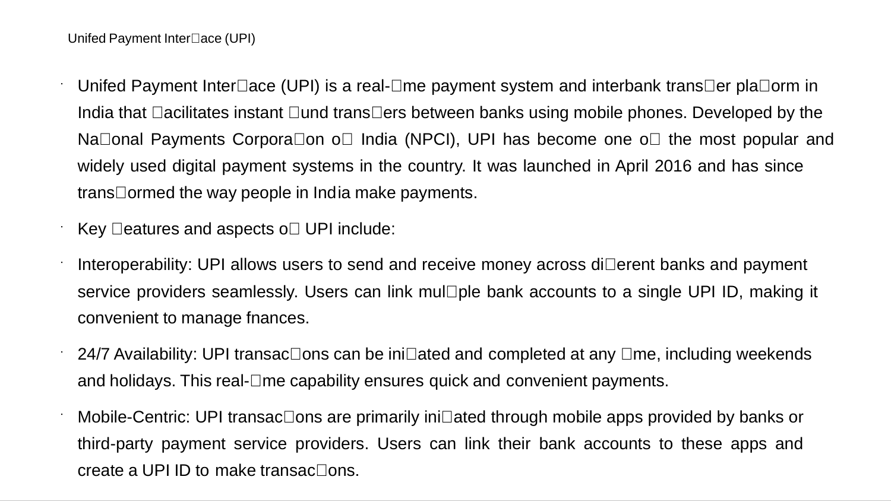

Slide 20
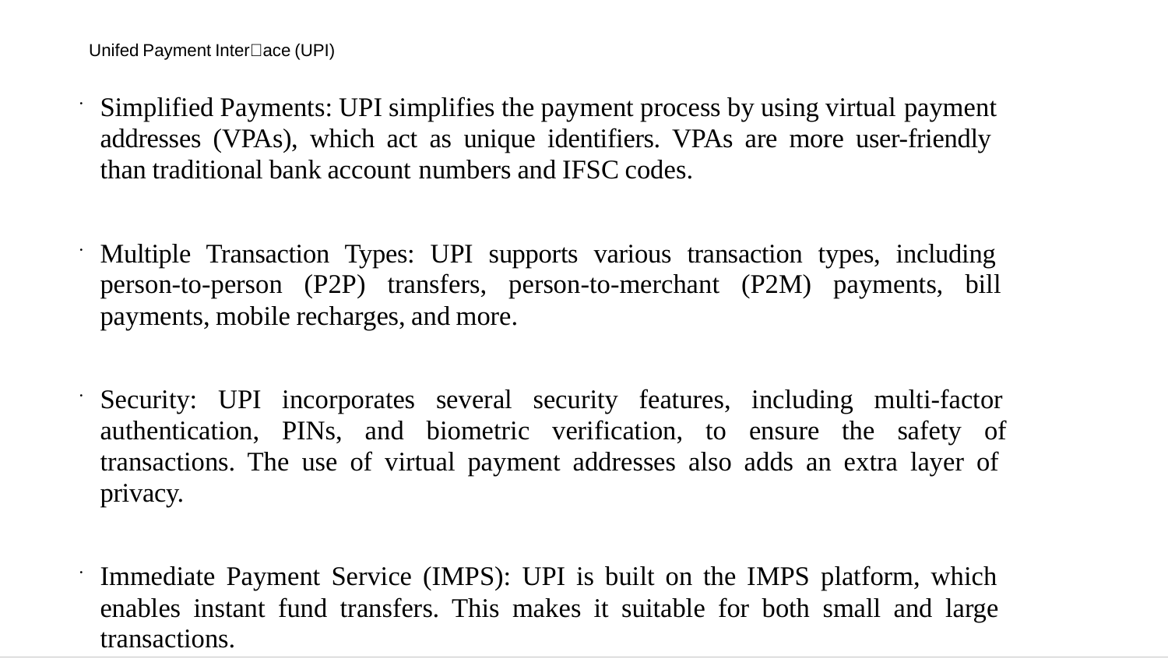

Slide 21
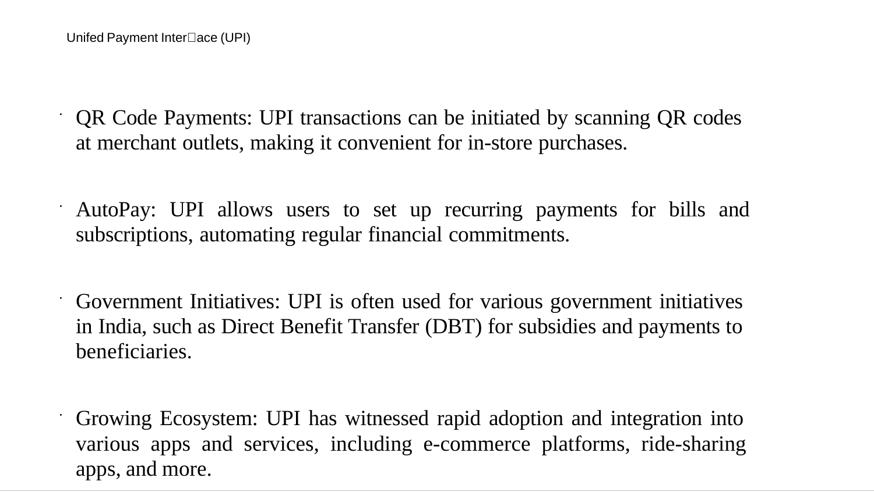

Slide 22
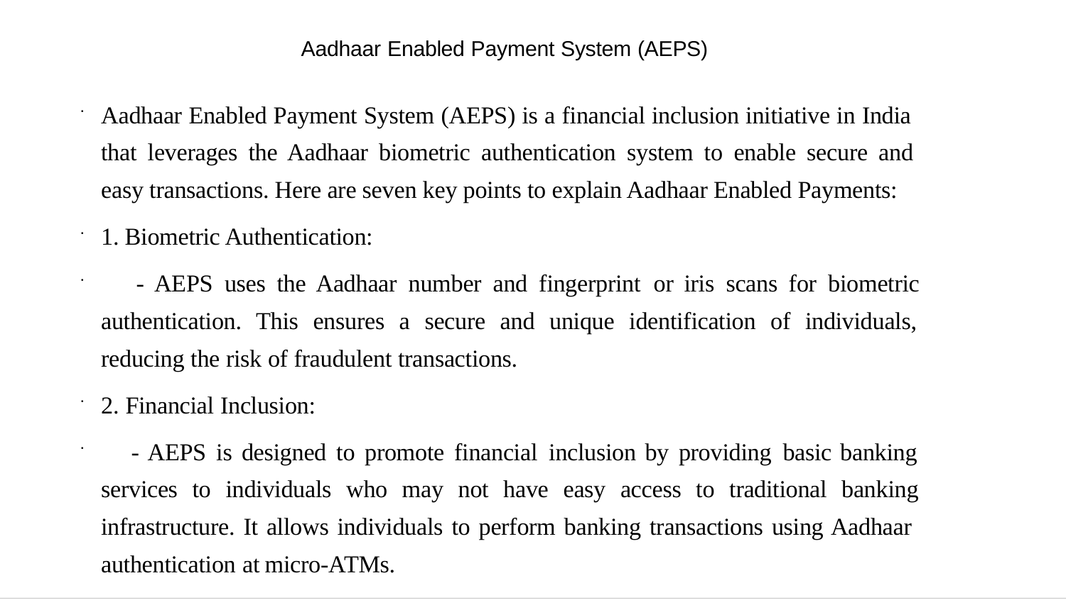

Slide 23
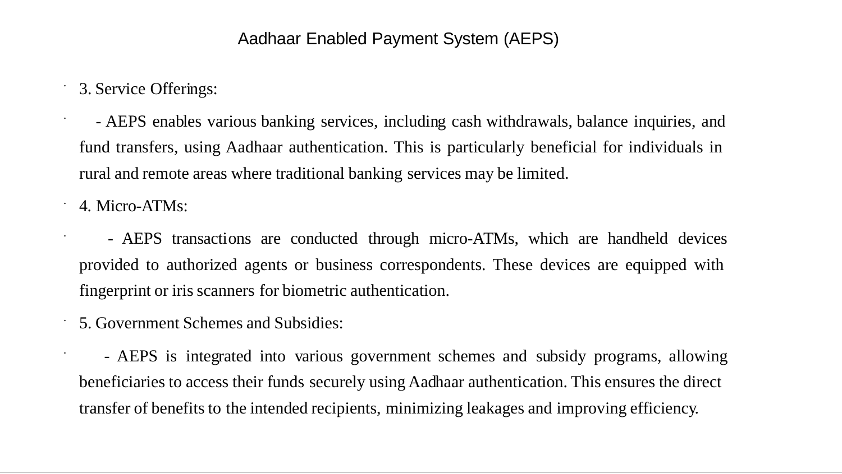

Slide 24
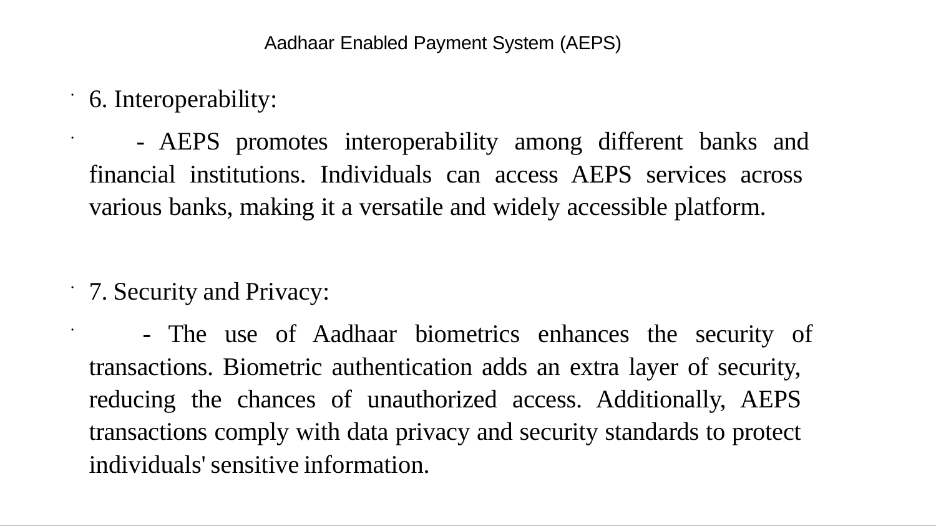

Slide 25
What is credit card fraud?
Credit card fraud refers to unauthorised transactions made using a counterfeit card, a stolen card, or stolen card details. There are various types of card fraud, and they can result in losses for both cardholders and merchants.
Card fraud encompasses the misuse of lost or stolen cards, where fraudsters use a card that belongs to someone else to withdraw money at a cash point or make a purchase in a physical location.
But that’s not the only way it happens. In many instances, card fraud results from perpetrators employing different techniques to access card details and then using that information to make a transaction online.

Slide 26
Types of credit card fraud
Within credit card fraud, there are two primary categories: card-present fraud and card-not-present (CNP) fraud.
Card-present fraud happens when someone makes an unauthorised card payment in a physical location, such as a shop or a cash machine.
Types of card-present fraud include:
Counterfeit: transactions involving fake cards created with stolen card data
Lost and stolen: when fraudsters exploit lost or stolen cards to make unauthorised purchases
Card not received: where scammers intercept cards sent by banks through the post
CNP (also known as remote purchase fraud) fraud happens when someone uses card details that aren’t theirs to make purchases without possessing the physical card. This is the most common type, accounting for 84% of card fraud in recent years.
Fraudsters use various techniques to obtain card details and make remote purchases:
Data breaches: fraudsters often go after retailers and banks by exploiting security weaknesses to steal card details and other identity information to make transactions
Phishing: criminals pretend to be legitimate organisations to trick others into sharing their card details through emails, websites, messages, or phone calls
Skimming: criminals use devices at ATMs or point-of-sale terminals to capture card information
Malware: fraudsters infect a device with malware to record keystrokes to steal card details

Slide 27
Credit Card Fraud Vs Charge Back Fraud
With credit card fraud, a criminal makes an unauthorised transaction using someone else's card. In contrast, chargeback fraud, sometimes called friendly fraud, involves a legitimate cardholder falsely disputing a valid transaction, resulting in merchant losses.
Chargeback fraud can occur when a consumer wrongly initiates a chargeback because they mistakenly believed they didn’t authorize a payment. For instance, if they forgot they made a purchase or didn’t recognise the billing descriptor. Equally, it can happen when a customer purchases something and then fraudulently claims they didn’t authorise the transaction or receive the product.
Notes:
While card issuers and banks protect consumers from card fraud, merchants have little protection against chargeback fraud.
Consumers can initiate chargebacks through their banks, and merchants have to try to prove that the cardholder authorised the transaction. Although merchants can contest chargebacks, banks and card issuers often rule in favour of consumers, resulting in losses and chargeback fees for merchants.

Slide 28
How card fraud impacts ecommerce merchants
Card fraud causes financial losses for merchants because they're often held liable. Additionally, instances of fraud give customers a negative image of the merchant, damaging customer trust and impacting retention.
Three parties could potentially be held liable for card fraud:
The cardholder: if they violate the terms or conditions of the card agreement, are found to be negligent in safeguarding their card details, or fail to report the fraud in a timely manner
The bank/card issuer: if their security or verification systems are inadequate
The merchant: if they don’t comply with security regulations, their security systems fail, or if it’s deemed they didn’t do enough to verify the identity of the person making the payment

Slide 29
In the case of card fraud resulting from large data hacks, insurance companies might also pay for some of the costs of the fraud.
Usually, if the cardholder reports the fraud promptly, they're not held liable, or their liability is limited to a small amount (£50 or less).
Clearly, this results in financial damage for online merchants. Let's say a fraudster uses a stolen card to purchase something from your online store. You'd end up having to refund the customer for the purchase amount, plus you lose inventory for the purchase.
Notes:
Banks tend to refund their customers, which means they lose money in the short term. However, banks and card companies can claim that the merchant is liable, blaming poor security.
When you pay online (no physical card), it’s called a CNP transaction. Since there’s no PIN entry at a machine, it’s less secure.
To improve safety, regulators introduced SCA (Strong Customer Authentication) — like OTP verification.
Real-world example:
While shopping on Flipkart or Amazon, you enter card details + receive an OTP on your phone to complete payment.

Slide 30
How to reduce card fraud
Ecommerce businesses have good reason to worry about card fraud: it harms customers and hinders growth. Here are a few ways to address it:
Watch out for suspicious activity
If everyone who deals with orders and payments on an ecommerce team is alert to the signs of CNP fraud, they can block or pause any potentially fraudulent transactions they notice.
Here are some potential indicators of card fraud to look out for:
multiple attempts to place an order
orders made with the same card from different IP addresses
orders where the billing address and delivery address are different
multiple orders sent to the same delivery address
unusual or spam-like email addresses

Slide 31
Follow online payment best practices
Ecommerce merchants must take action to keep fraudsters from using stolen cards on their sites. In general, they’ll need to implement measures in their payment flows to verify that the person making the payment is the cardholder.
Two-factor authentication (2FA) adds extra steps to a payment flow so customers can verify their identity. When 2FA is enabled, shoppers must enter additional information like a password or code sent via SMS to their phone. This makes it trickier for criminals to use someone else's card.
SCA is now required for online card payments in the UK and most countries in the European Economic Area. This regulation means all ecommerce businesses should have extra authentication steps in their card payment flows. SCA asks customers to verify their identity with two of the following:
something they know — like a password
something they own — like a card or a phone
something they are — biometric data like fingerprints
One way merchants can make sure they comply with these requirements is by using open banking payments, which have SCA built-in without adding any friction.
Another way to make payments on an ecommerce site more secure is to ensure they operate in line with Payment Card Industry Data Security Standards (PCI DSS). PCI DSS is a set of regulations that protect sensitive financial information during transactions and when stored or processed by businesses.
By complying with PCI DSS, merchants make it more difficult for hackers to obtain customers' card data. Non-compliance can leave merchants liable in the case of a data breach.

Slide 32
Use card fraud detection software
Card fraud detection software makes it easier to spot fraud. It uses algorithms to automatically check transactions and alerts merchants to potential instances of fraud. It will pause or flag a transaction for review if it looks suspicious.
Offer secure checkout with open banking
Even with added SCA steps, fraudsters can still steal cards and card details, making card payments inherently vulnerable to fraud. Offering alternative payment methods that are inherently more secure than cards helps protect businesses from credit card fraud.
Open banking payments, for example, are more secure than card payments. While card payments use SCA, the implementation of SCA for online card payments remains inconsistent. Additionally, open banking helps to reduce instances of fraud because there are no opportunities for fraudsters to steal card details. Open banking providers connect securely with the customer's bank to initiate the payment no sensitive information is shared with the merchant.
Notes:
Machine learning (ML) algorithms are making fraud detection software more effective. It finds patterns in a dataset without explicit programming. With ML, fraud detection systems can more accurately pinpoint fraudulent credit card transactions, decreasing the number of false positives.
However, this kind of software is about detecting and blocking fraud, and while it helps, it’s not 100% effective. If businesses reduce fraudulent attempts, they won't need to spend as much energy and resources on detecting them.
Most examples today show that it adds significant friction to the online commerce experience. On the other hand, open banking user flows have been designed and refined to comply with SCA in a simple and consistent way.

Slide 33
Encryption and Tokenization
Encryption and tokenization are both data security techniques. Encryption scrambles sensitive data, making it unreadable without a decryption key. Tokenization replaces sensitive data with a nonsensitive substitute (a token), which has no value on its own. The growth of online and digital payments has led to a rise in these security methods, with the volume of tokenized payment transactions projected to surpass one trillion globally by 2026.
How does encryption work?
Encryption transforms plaintext, the readable form of data, into ciphertext, an unreadable format. It transforms data by using a cryptographic algorithm (a set of mathematical rules that dictate how the data is scrambled) and a key (a piece of information, like a password, that’s used by the algorithm to encrypt and decrypt the data).
Here’s a simplified example of how it works:
Plaintext: “Hello”
Key: “Secret”
Algorithm: Caesar cipher (shifts each letter in the alphabet by a certain number of places)
Encryption: The algorithm, using the key “Secret,” shifts each letter in “Hello” by three places, resulting in the ciphertext “Khoor.”
Only someone with the correct key (“Secret”) and knowledge of the algorithm (Caesar cipher) would be able to decrypt the ciphertext back into the original plaintext.
There are many different types of encryption algorithms, each with varying levels of complexity and security. Some commonly used algorithms include Advanced Encryption Standard (AES) and Rivest-Shamir-Adleman (RSA).
The encryption’s strength depends on several factors, including the algorithm used, the key’s length and complexity, and the security of the systems for storing and transmitting encrypted data.

Slide 34
How does tokenization work?
Tokenization substitutes sensitive data such as a credit card number, social security number, and any other confidential information with a nonsensitive, randomly generated equivalent called a token.
This token is a string of characters that has no inherent value or meaning. Even if a token is compromised, it is useless to an attacker because it does not contain sensitive information.
There are numerous uses for tokens, making them a versatile tool for protecting sensitive data.
Tokenization systems manage the tokens and their relationship with the original data. These systems store the original sensitive data in a highly secure environment; this is often referred to as a token vault, which is isolated and protected from unauthorized access.
The system will then use the token instead of the original data when completing processes like transactions. In some cases, the system can retrieve the original sensitive data from the token vault using a process called detokenization, but it typically does so only when absolutely necessary and under strict security controls.
Tokens are irreversible by design, meaning they cannot be used to derive the original sensitive data without access to the token vault.

Slide 35
What is tokenization used for?
Tokenization keeps sensitive data secure and private in a wide range of industries and applications. Here are some common use cases:
Payment Card Industry Data Security Standard (PCI DSS): Tokenization protects credit card data. It helps merchants and payment processors comply with PCI DSS regulations by reducing the risk of data breaches and fraud.
Ecommerce: Tokenization secures online transactions, protecting customer payment information during processing and storage. This helps protect both businesses and customers from financial losses due to unauthorized access to card data.
Healthcare: Tokenization protects patient health information (PHI) by replacing sensitive data elements like Social Security numbers or medical ID numbers with tokens. This helps healthcare providers comply with Health Insurance Portability and Accountability Act (HIPAA) regulations and protect patients’ privacy.
Financial services: Financial applications like mobile payments, peer-to-peer transactions, and account linking use tokenization to protect sensitive financial data from unauthorized access and fraud.
Loyalty programs: Tokenization secures data from customer loyalty programs, including rewards points or membership numbers, to protect customers’ information and prevent misuse.
Data storage: Tokenization protects sensitive data stored in databases or the cloud, reducing the risk of data breaches and keeping information confidential.
Government and public sector: Tokenization protects sensitive government and public sector data like identification information, tax records, and Social Security numbers.

Slide 36
Tokenization vs. encryption: Key differences and how they work together
Tokenization and encryption are complementary data security techniques that are often used together. Encryption transforms plaintext data into an unreadable format (ciphertext) using a cryptographic algorithm and a key. Tokenization substitutes sensitive data with a surrogate value known as a token, which has no intrinsic value or meaning and bears no mathematical relationship to the original data.
Here’s some of their distinctions and functional overlap:
Technique Encryption Tokenization
Reversibility Reversible with the correct key Irreversible without access to the token vault
Data format Alters the original data structure Preserves the original data format
Security focus Protects data at rest and in transit Primarily protects data at rest
Compliance Helps meet compliance requirements Facilitates compliance by removing sensitive data
but might not fully isolate sensitive data. from the environment
Use cases Ideal for data that needs to be read and Best for data that needs to be referenced but not processed in its original form revealed
Tokenization and encryption together can create a layered security approach. Here’s a closer look at how they work together:
Tokenization for storage: A user tokenizes sensitive data and stores it in a database.
Encryption for transmission: When tokens need to be transmitted for purposes like payment processing, the user can encrypt them for secure communication.
Detokenization (if necessary): In specific scenarios that require access to the original data, authorized parties can use the token vault to detokenize the data under strict security protocols.

Slide 37
An example of using tokenization and encryption together
A retailer is storing customer credit card information. Instead of storing the actual card numbers, they use tokenization to replace them with tokens. The retailer uses the tokens for transactions, while the actual card numbers are securely stored in a token vault and encrypted for additional protection.
Best practices for using encryption and tokenization in your business
Encryption and tokenization are important components of a robust data security system. Here are some best practices for implementing effective, compliant security standards:
Compliance: Understand the relevant data protection regulations in your industry (e.g., PCI DSS, HIPAA, General Data Protection Regulation [GDPR]) to ensure your encryption and tokenization practices are in compliance.
Security audits: Regularly review and audit your encryption and tokenization processes to identify potential weaknesses and vulnerabilities.
Employee training: Educate your employees on the importance of data security and the proper handling of sensitive information.
Incident response plan: Plan a quick, effective response to possible security breaches.
Encryption
Here are some best practices for using encryption:
Use industry-standard algorithms like AES with appropriate key lengths (e.g., AES-256). Avoid outdated or weak algorithms.
Protect your encryption keys. Store them securely, tightly control access, and regularly rotate them.
Encrypt sensitive data when it’s stored on your servers, in the cloud, and when it’s transmitted over networks.
Use secure protocols such as Transport Layer Security (TLS) to encrypt communication channels to keep data transmitted between systems confidential.

Slide 38
Tokenization
Here are some best practices for using tokenization:
Prioritize tokenization for highly sensitive data such as credit card numbers, Social Security numbers, and any personally identifiable information (PII).
Store the original data and its relationship to the tokens in a secure token vault, separate from your production environment. Implement strong access controls and monitoring for the vault.
Consider format-preserving tokenization (FPT) to maintain the original format of the data to simplify integration with existing systems and applications.
Develop a clear policy for generating, using, and retiring tokens to ensure they are used appropriately and don’t become stale or vulnerable.
Combining encryption and tokenization
Here are some best practices for combining encryption and tokenization in your security system:
Combine the strengths of both techniques for greater security. Encrypt tokenized data to further protect it during transmission.
Use tokenization for the most sensitive data and encrypt other sensitive information to balance security with performance and usability.
Evaluate the risk associated with different types of data and apply appropriate protection measures accordingly. Not all types of data need the same level of security.

Slide 39
What is PCI compliance?
The term “PCI compliance” is actually referring to compliance to the PCI DSS - the Payment Card Industry Data Security Standard. This is a set of standards and requirements established by the PCI Security Standards Council to make sure that when customers use their credit cards (including online), businesses are taking steps to protect customers’ payment data.
Do eCommerce businesses need to comply with PCI standards?
Does your business need to be PCI compliant? For eCommerce, the answer is yes. Every business that collects, processes, stores, or transmits payment data is responsible for complying with PCI standards.
Within PCI compliance, there are two types of businesses that need to adhere to the standards: merchants and service providers. For purposes of eCommerce compliance, eCommerce businesses are merchants. Service providers include any other businesses that come into contact with your customers’ data, like your cloud provider.
Why is PCI compliance for eCommerce sites so important?
Unlike some privacy requirements like GDPR, PCI compliance is not a legal or regulatory requirement. It’s an industry-wide requirement that is enforced by major banks and credit card companies like Visa and MasterCard. These companies can leverage serious fines against your business if you don’t comply.
Notes:
On top of avoiding those fines, you can expect that if you’re doing business with new vendors, partners, or other key stakeholders, they may ask if you’re PCI compliant. They want to know that they’re doing business with someone that does their due diligence, and lack of compliance can be a deal breaker for customers.
Finally, remember that PCI compliance isn’t just about marking off a checklist. The standards exist for a reason: to protect customer payment data. If you’re abiding by the PCI DSS, you’ll have a lower risk for data breaches (and the PR nightmares, loss of trust, and potential legal liabilities that come with them).
‍

Slide 40
General Data Protection Regulation
In the digital age, ecommerce businesses thrive on personal data information about customers, their preferences, buying habits, and more. However, with the increasing reliance on customer data comes the responsibility to protect it.
The General Data Protection Regulation (GDPR) is a comprehensive data protection law that impacts any business that handles the personal data of European Union (EU) citizens or residents, including ecommerce businesses..
Why should ecommerce businesses care about GDPR?
Here are a few key reasons why ecommerce businesses should prioritise GDPR compliance:
Protecting customer trust
Avoiding hefty fines
Enhancing data security
Gaining a competitive advantage
Research says many ecommerce companies had to alter their practices and analytics tools to achieve GDPR compliance. This reflects the widespread impact of GDPR on day-to-day operations and the need for businesses to adapt to maintain compliance continuously.
Notes:
Customers increasingly know their data privacy rights and expect businesses to handle their personal data responsibly. GDPR provides clear guidelines for managing customer data, from obtaining explicit consent to ensuring transparency in data processing activities. By adhering to GDPR, ecommerce businesses can demonstrate their commitment to data privacy and foster customer trust and loyalty.
Non-compliance with GDPR can result in hefty fines of up to €20 million or 4% of a business’s global turnover, whichever is higher. For ecommerce businesses, particularly small and medium-sized ones, these fines can be financially crippling. Moreover, non-compliance can lead to significant reputational damage, as data breaches or personal data mishandling can lead to customer loss.
GDPR mandates strict security measures to protect personal data from unauthorised access, breaches, and misuse. By implementing these measures, ecommerce businesses can reduce the risk of data breaches, safeguarding their customers and business operations.
As per IBM report, the global average cost of a data breach in 2024 is $4.88 million—a 10% increase from last year and the highest ever recorded.
In a market where consumers are increasingly concerned about data privacy, being GDPR-compliant can set your ecommerce business apart from competitors. By openly communicating your commitment to data protection and compliance with GDPR, you can attract and retain customers who prioritise their privacy and are likelier to do business with a trustworthy and responsible brand.

Slide 41
Key GDPR requirements for ecommerce
Understanding and adhering to the key GDPR requirements is essential for ecommerce businesses. Let’s break down these requirements to provide a clearer picture of what GDPR compliance entails:
Lawful basis for processing data
Under GDPR, businesses must have a lawful basis for processing personal data. This can include:
Consent: Obtaining explicit consent from the individual before processing their data.
Contractual necessity: Processing data as necessary to fulfil a contract with the individual, such as processing payments or shipping orders.
Legal obligation: Processing data to comply with a legal obligation, such as maintaining tax records.
Legitimate interests: Processing data for the business’s legitimate interests, provided the individual’s rights and freedoms do not override these interests.
For ecommerce businesses, consent and contractual necessity are the most commonly seen lawful bases for data processing.
Explicit consent
GDPR requires businesses to obtain explicit, informed consent from customers before collecting and processing their personal data. Consent must be freely given, specific, informed, and unambiguous. This means:
No pre-ticked checkboxes: Customers must actively opt-in to data collection. Pre-ticked checkboxes are not allowed.
Clear language: The language used to obtain consent must be clear and easy to understand, avoiding legal jargon or complex terms.
Granular consent: If you are collecting data for multiple purposes (e.g. email marketing, analytics, and order processing), you must obtain separate consent for each purpose.
Customers also have the right to withdraw their consent at any time, and your ecommerce store must make it easy for them to do so by offering a simple unsubscribe option.
Notes:
Consent:
Customer gives permission
👉 Example: You agree to receive promotional emails from Amazon Contractual Necessity:
Needed to complete a service
👉 Example: Your address is used to deliver an order from Flipkart Legal Obligation:
Required by law
👉 Example: Storing transaction records for tax purposes Legitimate Interest:
Business interest without harming user rights
👉 Example: Fraud detection systems

